Slide 1
Affordable Housing Scrutiny Committee
23rd January 2013

Slide 2
Agenda Item 4
Three Dragons Toolkit
Policy (includes approaches elsewhere)
Supplementary Planning Guidance
Defining affordable housing
Members emails v helpful
Q & A anytime
Main issues
Other issues – please raise
Tweaked the order (4a to 4e)

Slide 3
Three Dragons
Demo
Developer’s profit
Exceptional land costs
Flexibility on the % requirement
Commuted Sum
Reaction of applicants & agents
Inspectorate endorsement of the approach
Notes:
The use of the Three Dragons Toolkit (P Barlow demonstration)
Demo taking Members through the New Hedges allocation - cover
Developer’s profit
Exceptional land costs
Flexibility on the % requirement as a result of
Little Haven Walton Hill – Appeal decision on DM committee that morning – Commuted Sum – MD to cover
Reaction of applicants agents
Inspectorate endorsement of the approach

Slide 4
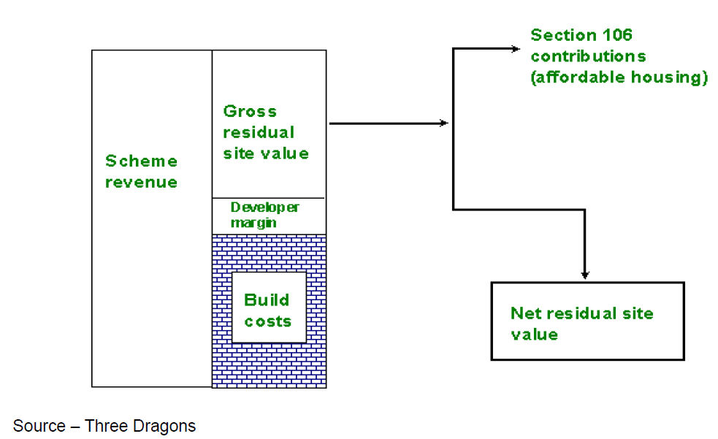
Three Dragons Toolkit: Principles and Application
Works on the principle of Residual Land Value (Figure 1)
Allows us to test the impacts of:
Varying the target for affordable housing
Planning obligations (S106 and Community Infrastructure Levy)
The availability Social Housing Grant (SHG)
(Planning obligations)
(Figure 1 – Residual Value)
Notes:
Residual Land Value is the value attributed to a piece of land, on which a scheme will be carried out, after costs and developer margin have be subtracted from any revenue from selling the buildings
Net Residual Value is Gross Residual Value less any costs attributed to planning obligations such as affordable housing
Toolkit allows for a proportion of build costs to be covered by SHG

Slide 5
Three Dragons at PCNPA
What do we use it for?
To help us negotiate with developers, and maximise the level of affordable housing contribution made by new housing developments
To check figures provided to us by developers
To calculate commuted sums on small developments (less than 2 units)
Notes:
Developers come to us with a proposed scheme, we use the toolkit to check their figures and negotiate an appropriate level of affordable housing (if necessary)
Three Dragons helps us to reach a fair and equitable agreement to balance our needs

Slide 6
Basic Site Information

Slide 7
What type of home and how many?
“No. of Storeys” – applies to flats only
Toolkit considers parking (surface and under croft) and the costs
Notes:
Tookit allows consideration of the costs incurred from building multi-storey apartment complexes

Slide 8
Market Value
There are no default prices
Notes:
The toolkit does not provide default market values, so we must use the most recent data for the area in question. This is done using the land registry price paid data (free monthly) or buy using values provided by the developer i.e. What they expect to market the properties for (again we check this to make sure we think that it is reasonable asking prices).

Slide 9
Tenure Mix
% Affordable housing...

Slide 10
Results
Net Residual Value
Notes:
A positive Residual value is a good start but this does not mean that the scheme is viable
The residual value must higher than the existing/ original use value – in most cases in the national park it would be farmland – or else why would you bother to develop if it is worth more in it’s original state?
The

Slide 11
Policy - Flexibility
Policy wording Policy 45..., Page 75
Supplementary planning guidance,
Land Availability Inspector’s Report, page 4 The Inspector’s report into land availability (April 2011)
Notes:
Is our policy flexible enough? Does it require review? (MD)
Point out built in flexibility: Policy wording Policy 45..., Page 75 supplementary planning guidance, Land Availability Inspector’s Report The Inspector’s report into land availability (April 2011)
Can we/should we review policy now?
E Ancrum response E Ancrum email – cannot do a partial review.
Needing time to bed in (use A Archer text)
A review of policy likely to stall current negotiations/progress Link to Sarah M work..doesn’t appear to be hampering negotiations/bringing sites forward , link to current S106 agreements etc.

Slide 12
Reviewing Policy
Needing time to ‘bed in’
Summary of policies being used elsewhere in Wales
Stalling current approach
link to current S106 agreements etc.
Sites Table SM
Welsh Govt advice
Notes:
Is our policy flexible enough? Does it require review? (MD)
Point out built in flexibility: Policy wording Policy 45..., Page 75 supplementary planning guidance, Land Availability Inspector’s Report The Inspector’s report into land availability (April 2011)
Can we/should we review policy now?
E Ancrum response E Ancrum email – cannot do a partial review.
Needing time to bed in (use A Archer text)
A review of policy likely to stall current negotiations/progress Link to Sarah M work..doesn’t appear to be hampering negotiations/bringing sites forward , link to current S106 agreements etc.

Slide 13
Reviewing Policy cont’d
Using lower percentages
PCC Plan Affordable Housing SPG page 6 NOT PUBLIC, PCC Plan page 109
Notes:
More flexibility – with lower percentages it can be more onerous confusing to operate – e.g. PCC Plan Affordable Housing SPG page 6 NOT PUBLIC, PCC Plan page 109

Slide 14
Supplementary Planning Guidance
Potential to improve the offer for developers on private Low Cost Home Ownership/rental properties (but keep them affordable), eg. PCC draft SPG page 13.
Land is our priority – P Barlow example??
Flexibility regarding design (Crymych & Marloes examples SM) & additional WG funding
mortgage lending
Review of Choice based lettings PCC
County Council Supplementary Planning Guidance Consultation
Deliverability Study – awaiting outcomes – mailshot/contact landowners/agents.
Notes:
Supplementary planning guidance (MD)
Potential to improve the offer for developers on private Low Cost Home Ownership/rental properties (but keep them affordable), eg. PCC draft SPG page 13.
Land is our priority – P Barlow example??
Flexibility regarding design (Crymych & Marloes examples SM)
Occupancy controls and mortgage lending
Review of the County Council’s Housing Allocations Policy
County Council Supplementary Planning Guidance Consultation
Deliverability Study – awaiting outcomes – mailshot/contact landowners/agents

Slide 15
Defining local need
How housing need was calculated for the Plan
Notes:
Is there a wider definition of affordable housing need that the Authority is not taking account of? (MD)
How housing need was calculated for the Plan

